Slide 1




Fuel Cell Laboratory
Arizona State University – Polytechnic
presented by Eric Hinkson

Slide 2
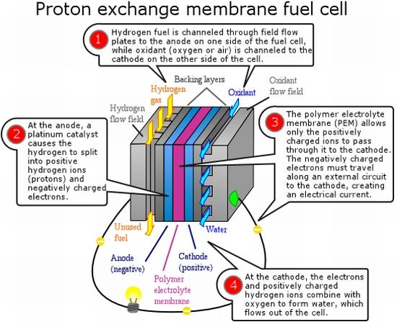

Polymer Electrolytic membrane fuel cell (PEMFC)
Image courtesy of http://www.ecofriend.com/tags/pemfc/
Notes:
Membrane acts as the electrolyte, allows proton to pass through but not electrons.
Membrane does not have enough energy to split Hydrogen and Oxygen fast enough to meet power requirements, so a catalyst (Platinum) is used to speed up the reaction.
In addition, only platinum can be used as a catalyst due to the low activation energy which results from its use as the catalyst that is not produced by other catalyst materials.

Slide 3
Fuel cell lab: research 2011-2012
Multi-walled Carbon Nanotubes (MWCNTs)
Functionalized vapor grown carbon fibers (VGCF)
Platinum-Copper Core-Shell

Slide 4
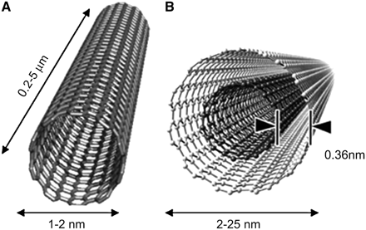
Functionalized mwcnts
Reasons for f-MWCNTs:
Greater durability
Increased electrical conductivity over conventional carbon
Improved fuel cell performance – improved power density
Image courtesy of http://jnm.snmjournals.org/cgi/content/full/48/7/1039/FIG1

Slide 5
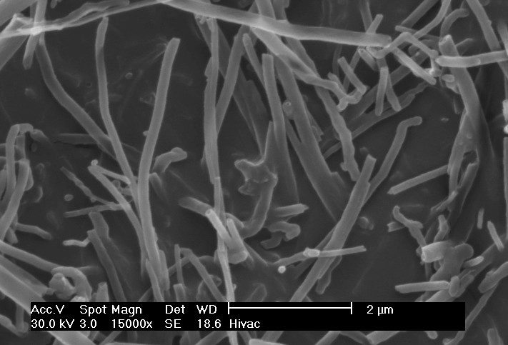
Functionalized vgcf
Why is this useful?
Fuel cell cost
Reported improved durability
Simplified, controllable manufacturing process
SEM image ourtesy of http://cnx.org/content/m22580/latest/?collection=col10719/latest

Slide 6
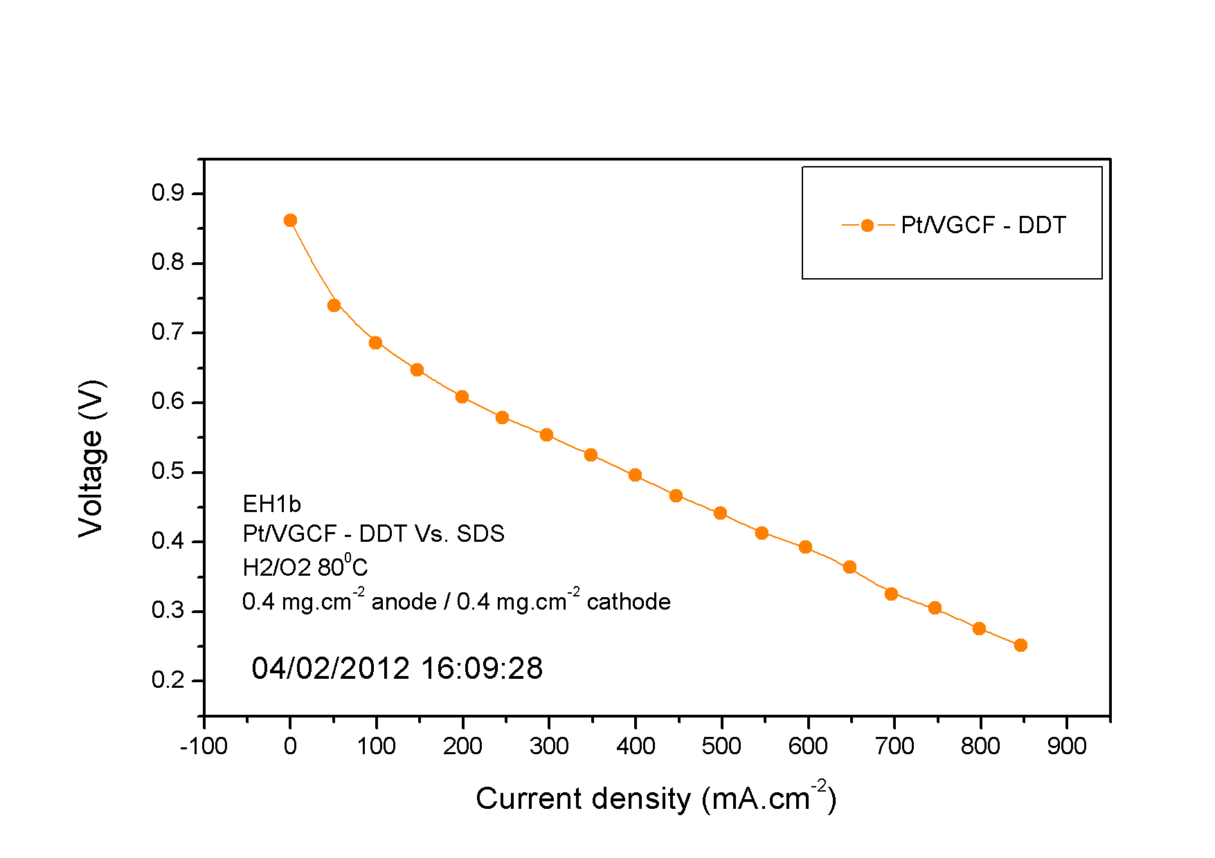
Functionalized vgcf – Preliminary results
Using dodecanethiol (DDT) surfactant:
Lower current density than f-MWCNT
Further experimentation will reveal conclusive results.
SEM image ourtesy of http://cnx.org/content/m22580/latest/?collection=col10719/latest

Slide 7
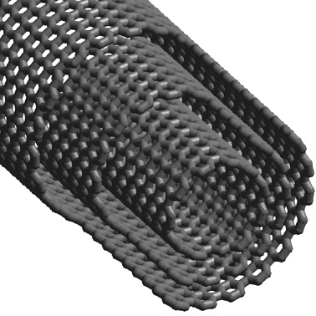
Core-shell
Pt-Cu Alloy Seed
Pt only
Pt layer – few atoms thick
Why is this useful?
Fuel Cell cost
Durability
DOE Requirements
Notes:
Needed to reach DOE requirements for fuel cell cost per kg of Pt in fuel cells
Copper seed, 3-5nm diameter, using ion exchance process to remove Cu ions at the surface of the seed and replacing them with Platinum ions. Pure center is pure Cu, outside is pure Platinum, in between is incomplete reaction, some Cu some Pt ions.

Slide 8
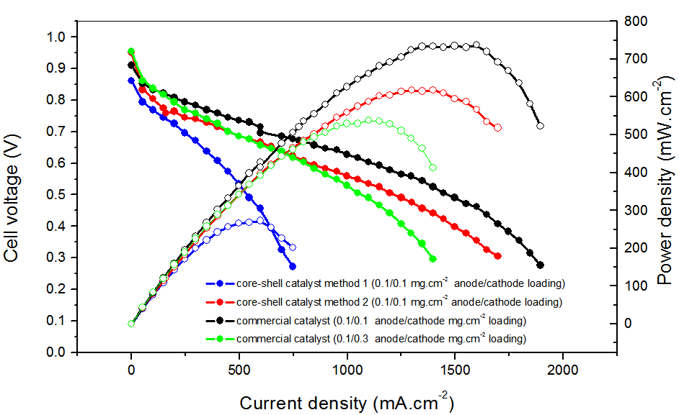
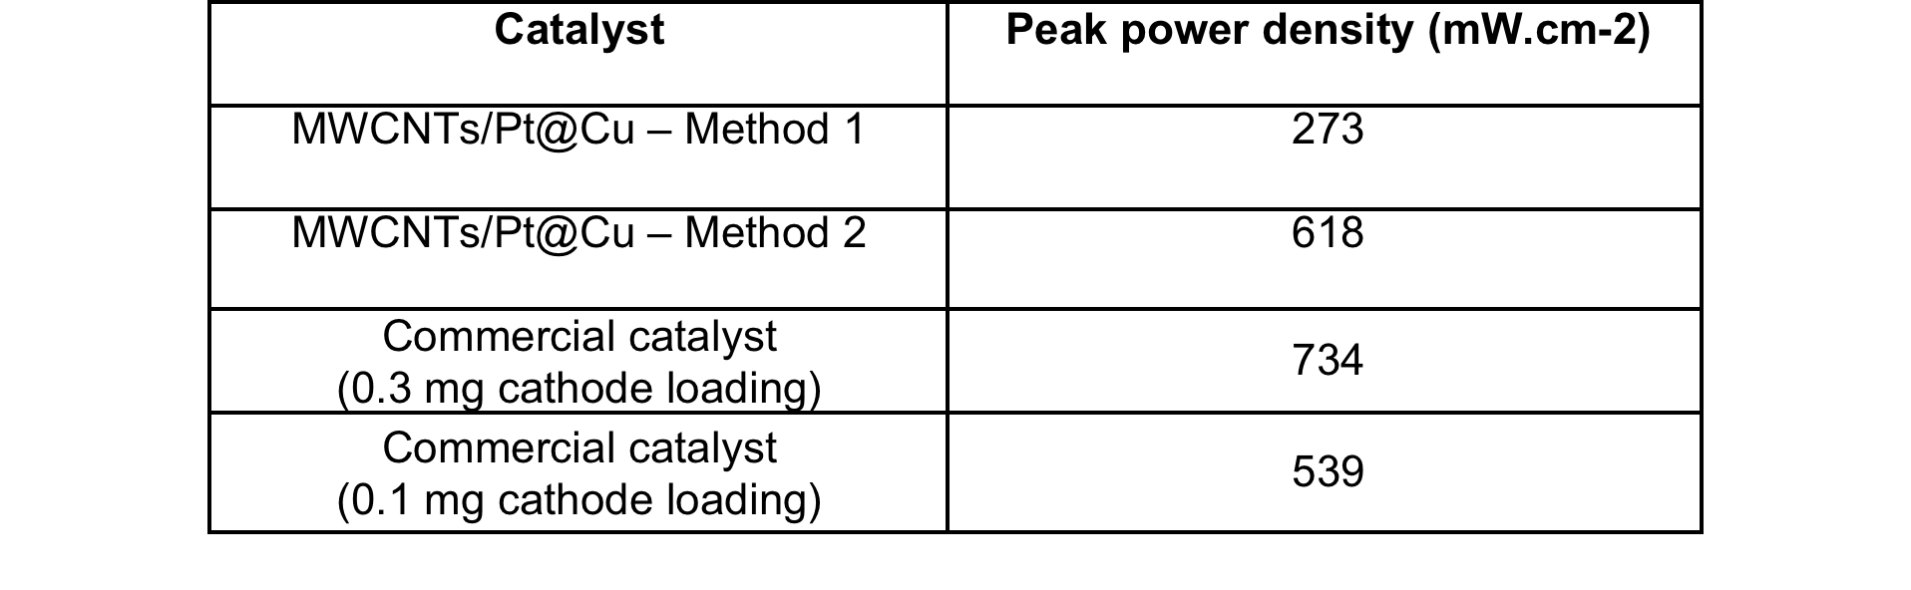
Core-shell - Results
Core-shell method 1 – Relatively poor performance.
Core-shell method 2 – Performance comparable to commercial catalyst low Pt loading
Notes:
Needed to reach DOE requirements for fuel cell cost per kg of Pt in fuel cells
Copper seed, 3-5nm diameter, using ion exchance process to remove Cu ions at the surface of the seed and replacing them with Platinum ions. Pure center is pure Cu, outside is pure Platinum, in between is incomplete reaction, some Cu some Pt ions.

Slide 9
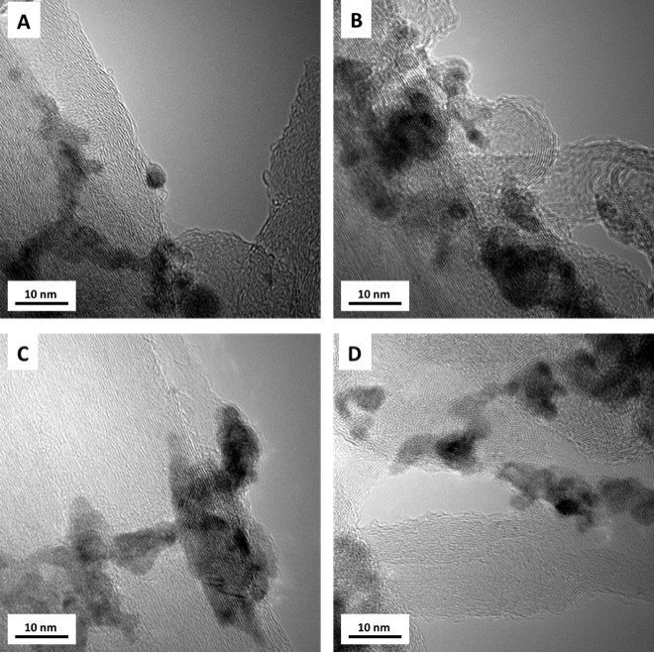
Core-shell - Results
Notes:
Needed to reach DOE requirements for fuel cell cost per kg of Pt in fuel cells
Copper seed, 3-5nm diameter, using ion exchance process to remove Cu ions at the surface of the seed and replacing them with Platinum ions. Pure center is pure Cu, outside is pure Platinum, in between is incomplete reaction, some Cu some Pt ions.

Slide 10
outcomes
Experience working in a professional lab environment
Opportunity to put classroom knowledge to real world applications
Renewed passion for science and engineering
Increased confidence in scholarly abilities
Department of Defense SMART Scholarship Award
2011 NASA Academy at Ames Research Center

Slide 11



Special Thanks to:
ASU/NASA Space Grant
Dr. A.M. Kannan (Mentor)
Anthony Adame (Graduate Mentor)
Rashida Villacorta (Graduate Mentor)
The rest of the ASU Polytechnic Fuel Cell Lab Team
Tom Sharp
Candace Jackson
Stefanie Miller

